Slide 1
Centroid-based summarization of multiple documents
Information Processing and Management@2004
20131016

Slide 2
Introduction
This paper present a multi-document summarizer, MEAD, which generates summaries using cluster centroids produced by a topic detection and tracking system.
Two new techniques, a centroid-based summarizer, and an evaluation scheme based on sentence utility and subsumption.

Slide 3
What’s centroid ?
A centroid is a set of words that are statistically important to a cluster of documents.
Centroids could be used both to classify relevant documents and to identify salient sentences in a cluster.

Slide 4

As new documents are processed, their TF * IDF values are compared with the centroid using the formula

Slide 5
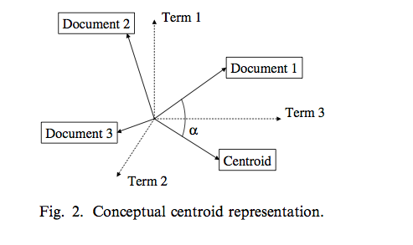
Aa

Slide 6
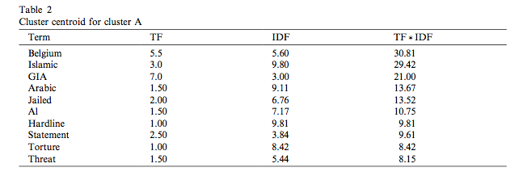
Cluster sample

Slide 7
Extract Alg
Count = N * r
N: number of documents
R: extract rate
Feature
Centroid value, Positional value, and First-sentence overlap.

Slide 8


Centroid value
Positional Value

Slide 9


First sentence over-lap
Alg

Slide 10
Redundancy Alg
Score(s)

Slide 11
Thanks!

